Slide 1

Lightspeed
(formerly vend)
An instruction booklet
Updated January 2026
Created by: Kelli Kolasa/Silvija Haas

Slide 2
Table of Contents
3 - Help me!!
4 - What is Lightspeed?
5 - Login credentials
6 – PCI DSS Recertification (yearly)
7 - Opening register
8 - Components of a sale
9-10 - Adding a customer to a sale
11 - Products
12 – 13 Quick keys
14 – 17 Making a sale
15 - Tax Exempt sale
18 – 19 Split payments
20 - Payment Types
21 – 22 - Overages/Shortages
23 – 25 Making a return
26 - Receipts
27 - Reviewing transactions
28 – 30 Reviewing checks
31 – 34 Closing register
35-52 Preparing Deposits ** updates 1/5/23
53 – Submitting Deposits
54 – Common Mistakes
Click the link to view slide topic

Slide 3

SEND HELP!
If you’re stuck on something, don’t spend more than 5 minutes trying to figure it out.
Preferred method of contact is email: msue.vend@msu.edu
Send all questions to msue.vend@msu.edu
USPS Mailing address:
        MSU Extension
        Justin S Morrill Hall of Agriculture
        446 W Circle, Room 160
        East Lansing, MI 48824
Additional resources are available at the MSU Extension OD Website

Slide 4

What is Lightspeed?
Lightspeed, formerly known as VEND (and likely to still be referred as VEND) is an electronic, web-based point of sale & retail management system that makes selling products to customers very easy.
We use this system because it allows us to have consistent pricing and an accurate way to record money received in each county office. Money collected is from selling products, registrations or collecting donations.
Paper receipt books should only be used when collecting money off-site at a meeting- that way, the customer gets a receipt for the payment. If you’re in the extension office collecting money for a sale, the cash register must be used!
Most offices use an iPad and clover credit card. Your office set up could be different. When you experience problems with any equipment, please reach out to msue.vend@msu.edu
Attention to detail is key when it comes to using this system. The phrase garbage in, garbage out applies. The quality of output is determined by the quality of input.
This system is not used to record registration payments for Events Management .
Pay close attention to details!

Slide 5



How do I get access?
#1 - District Director or District Support identifies you need access
#2 – PCI DSS Employee Payment Security Statement
#3 - Login created
My account isn’t working!
User signs the security statement, and returns to Lightspeed admin. You’ll receive email with login access to portal.
User reviews Overview: Video of System .While the video may look slightly different from Lightspeed (name change/color scheme), the principles remain the same
msue.vend@msu.edu will create your login. You’ll receive an email with login & detailed information.
Save and refer as needed.
Never share logins with anyone.
Is your account active? Could it have been deactivated?
If you’ve forgotten your password, follow prompts for “forgot your password”
The system will send you an email link to reset your password.

Slide 6
Yearly PCI DSS Certification
The Payment Card Industry Data Security Standard (PCI DSS) ensures the secure handling of payment transactions. As a user of the Lightspeed cash register system, you are required to maintain compliance by signing a payment card security statement.
To remain compliant, MSU requires annual PCI DSS recertification. This means that every year, users of Lightspeed will need to initial and date the payment card security statement. These signed statements will be retained by the Lightspeed staff.
Failure to sign the security statement will result in the deactivation of your Lightspeed access.

Slide 7

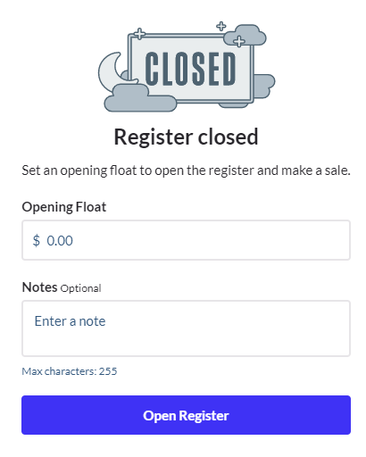
Opening your register
Why?
How?
When?
You need cash in order to give change to customers paying cash.
These internal controls are necessary to prevent mishandling of money and to safeguard assets against loss or theft.
Strong internal controls promote operational efficiency, and they also ensure reliable accounting records.
Physically touch the dollar bills & coin to count, then enter this amount as the opening float.
NEVER recall the amount from memory.
When you enter the amount for the Opening Float you are electronically making an official statement that you’ve counted the money, and this is the amount you are starting with.
While you should have the same opening float, mistakes do happen and there could be an instance where the starting float is different.
When this happens, be sure to report this immediately.
At the start of each business day, you must open your register and add the starting balance- this is your opening float.

Slide 8
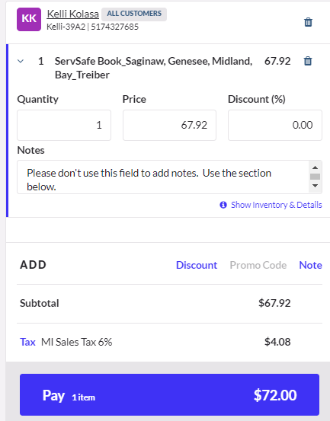

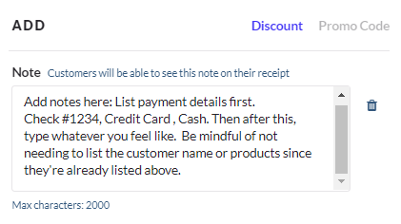
Sell Screen
Shopping Cart
What are all the sections of the shopping cart?
Customer – the person who is making a purchase
Products – the actual item(s) being purchased. Change the quantity if multiple items are needed.
Sales tax – applicable on tangible items unless the customer is tax exempt
Notes –identify the payment type so it reflects on sales history.
The total the customer owes
Unfortunately, there are two areas where notes can be added on this screen.
*NO* Directly below the product in the cart. Does not carry over.
*YES* Selecting the “note” will expand to the correct spot to add notes. These will carry over to helpful areas of the cash register system.

Slide 9
Customers, part 1
Add customer name each time a sale is made.
  Best to do at beginning of sale but can be done after. Adding a customer after the sale is tedious.
Avoid creating duplicate customers.
At minimum, collect phone number. We like to have this in the event we need to contact them regarding a sale. You could also collect email, helps for emailing receipts to them.
  Both pieces of information make finding transactions easier- especially if they have a common name.

Slide 10
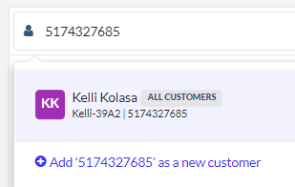
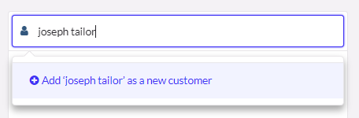
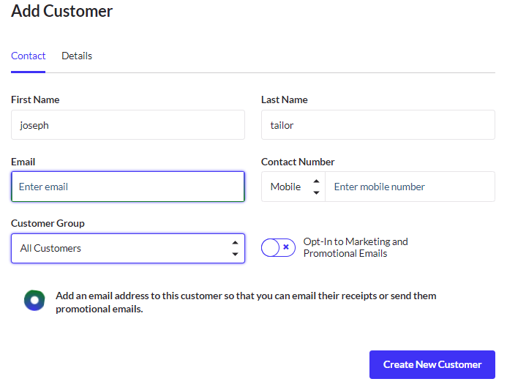
Customers, part 2
I started typing in the customer's name and they do not exist. Click “add” as a new customer. A new screen will pop up and you can add their email & phone number.
When searching, be careful on spelling, typos, etc.
I started typing in a phone number. The matching customer result popped up. To add this customer to the sale, click on the name.
Enter first, last name, email & phone number, then create.
Do not create customer group. Do not change to opt-in to marketing & promotional emails.

Slide 11
Products
A product is the item created to sell to customers.
Lightspeed admin creates each product and makes available in the system.
Information collected for new products include:
1. Name of the item
2. Cost per unit (include any shipping/discounts)
3. How long should the product be available to sell?
4. Account/sub account for income
5. Sales tax
Where applicable, a pricing model is applied to cover costs like shipping or additional expenses incurred to get the product to your Extension location.
New products are created for each instance. Selecting a product in the cash register needs to match exactly what the customer is purchasing.
Example: If a customer wants to purchase a Book on Pottery, but no product is available, you should not select a product for a Book on Woodworking because it’s the same cost or kind of the same item. A new product would need to be created before the sale could be made.
Asking staff to plan ahead for items they will sell is strongly encouraged and should be discussed in each office frequently.

Slide 12
Quick Keys, part 1
Quick keys are tiles created from products that can be listed on the sell screen.
Each register is customizable.
Make the system as user-friendly as possible and update quick keys frequently.
The Manager has the capability to add, remove and edit quick keys as often as needed.
The OD Lightspeed Site has written detailed instructions
For a quick video demonstration – focus on the time for .28 – 1:43.

Slide 13
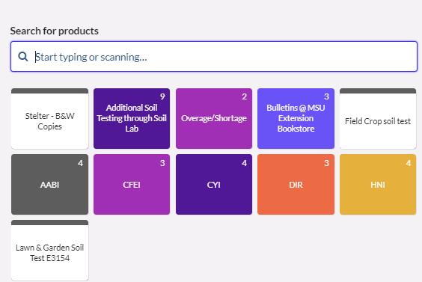
Quick keys, part 2
A number in the corner indicates additional products are in the folder - for this example there are 9.
Add or remove tiles as needed
Color code them or arrange them for functionality

Slide 14
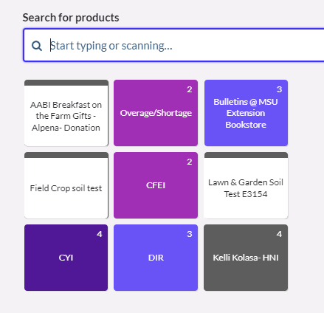
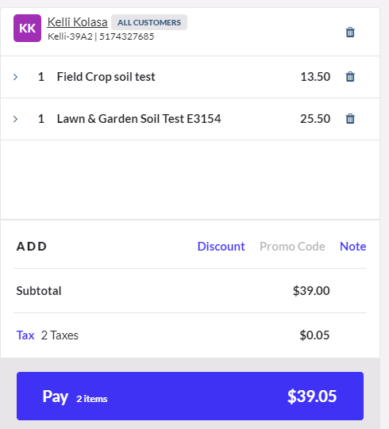
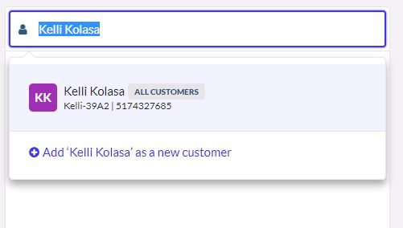
How to make a sale, part 1
Add customer
Add products
Collect money
When possible, add the customer's name to the sell screen
Find the product the customer is buying from the quick keys or search bar and add to cart on the sell screen
Find the total the customer owes. The products + sales tax.

Slide 15
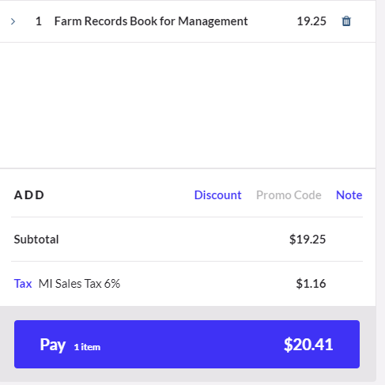
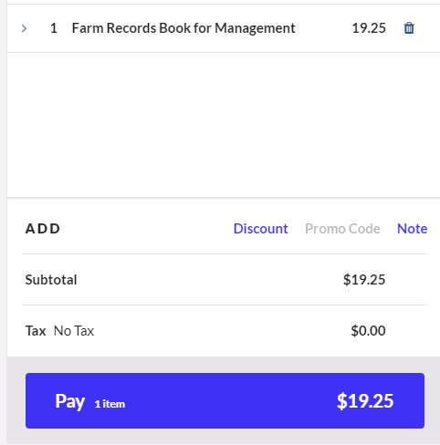
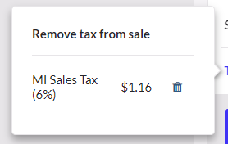
How to make a sale, part 2 (sales tax)
Sales tax is automatically calculated in the system when the product is added to the cart.
If a customer is tax exempt- they need to provide their tax-exempt certificate. MSUE locations keep a copy on file.
If they don’t have the certificate, they could fill out a tax-exempt form found on the OD site.
If they can’t provide certificate or fill out form, they are required to pay tax.
Click on the blue “Tax” and a new window will pop up. Click the trash can icon to remove tax from sale. Cart will update to show no tax.

Slide 16
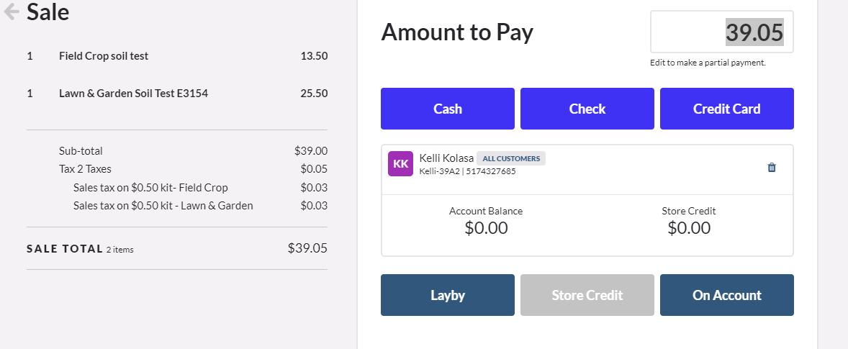
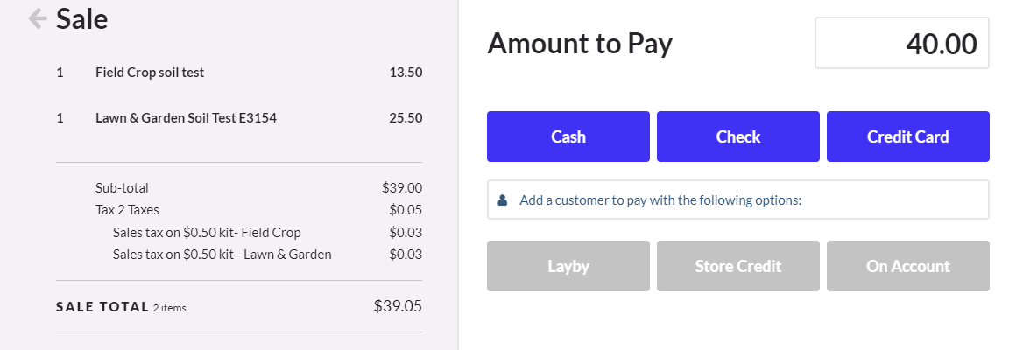
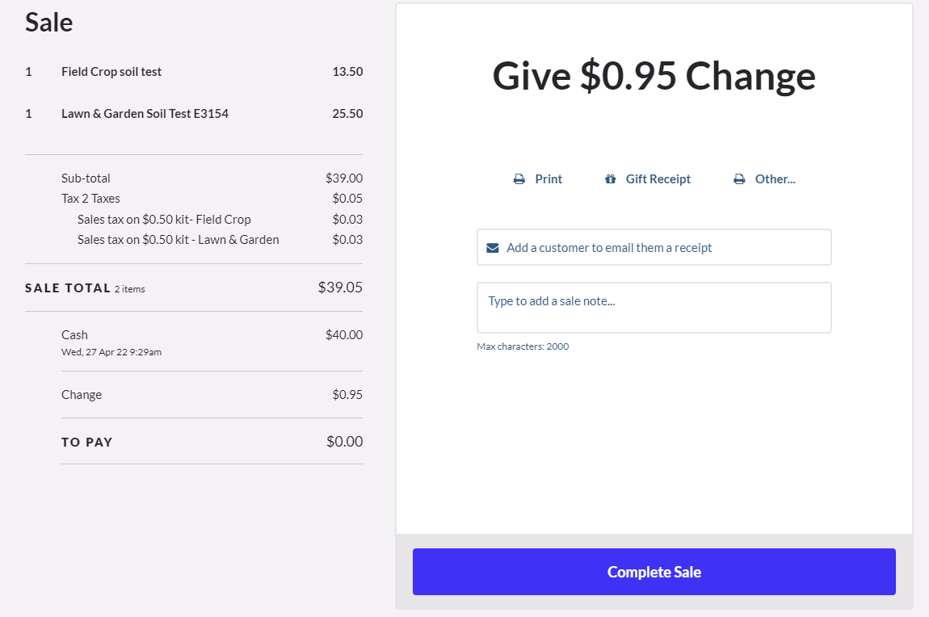
How to make a sale, part 3
Enter the amount the customer is paying.
  The system carries over the amount due in the amount to pay field. If they are paying a different amount, you must change it here. I’ll change it to show the customer is paying $40.00
Select the type of payment: cash, check or credit card
When applicable, give change to customer.
Then, click complete sale to finalize transaction and print a receipt.
Cash is NEVER to be given as change to a customer paying by check or credit card

Slide 17
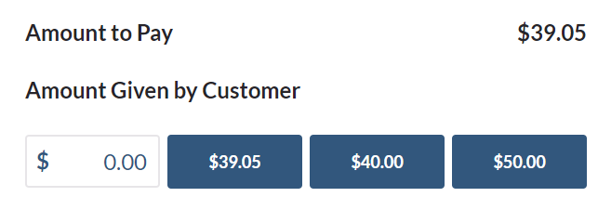
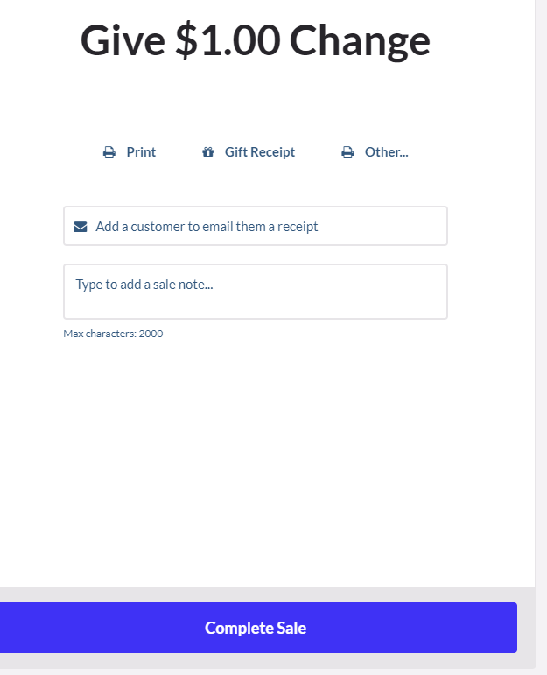
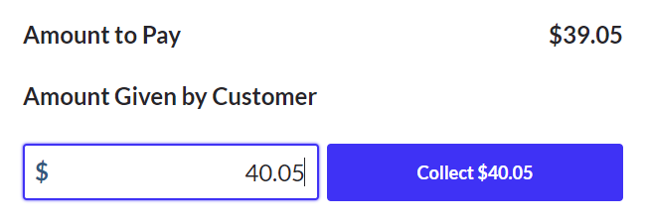
How to make a sale, part 4
Here is an example showing the customer is paying the exact amount. A screen pops up to ask you what amount was given by the customer- you can type in the amount or select the prepopulated amount.
Always record the exact amount given by the customer. For this example, if the customer gives $40.05 cash, you should not record they gave $39.05 and do the mental math of giving them $1.00 in change. The best way, is to record they paid $40.05 and the receipt will show $1.00 in change to be given back.

Slide 18
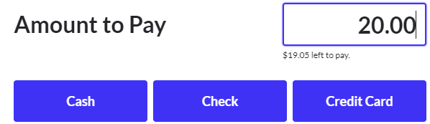
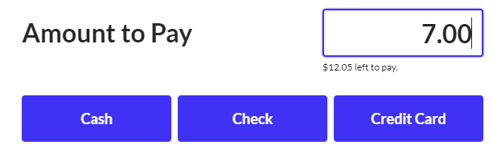
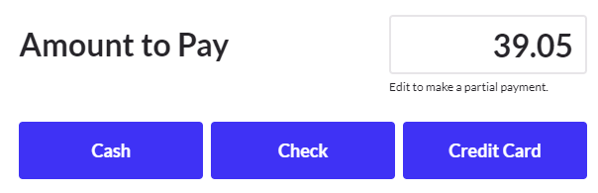
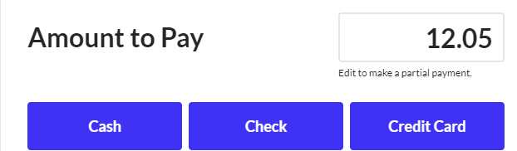
Split payments, part 1
The sale in the past slide is the same example. We will show how to record a $20 cash, $7 check, and $12.05 credit card payment.
At the pay screen, change the amount the customer is paying and select the type. You do this for each tender type and amount the customer is paying.

Slide 19
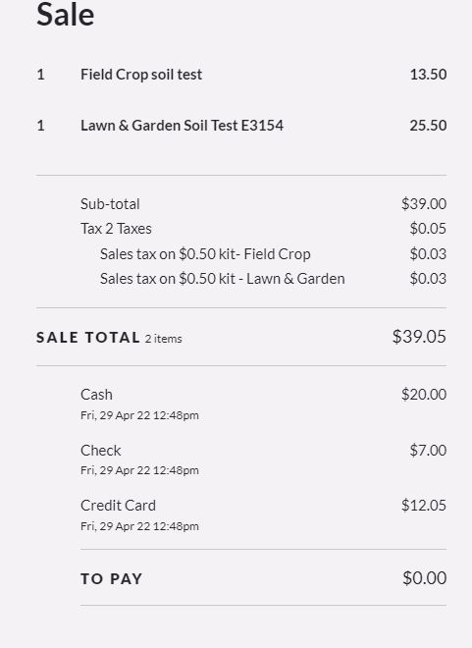
Split payments, part 2
This is what the receipt will look like after the payments have been applied.
See how it identifies the payment types clearly?

Slide 20
Payment types
When a customer is paying by credit card, pause at the screen (how to make a sale part 1- collect money) and run the credit card payment through the credit card device.
Once the payment is successful, switch back to Lightspeed and “Complete Sale” to record the payment and sale in the system.
Doing this will help save time when the credit card sale is declined- you could ask the customer for a new form of payment or even discard the sale if they can’t pay.
Failing to click complete sale will not record transaction and make your register out of balance.
The QR code itself will be handled by the customer and will use their personal smartphone. Any individual with Lightspeed access will be able to display/show the QR code to the customer and collect confirmation. Please feel free to post the following document with payment instructions close to the register.
Staff will ring up the sale in Lightspeed, then pause at the pay screen and wait for the customer to scan the QR code and input their credit card payment details. Once payment is successful, the customer can show or tell you the confirmation number.
Acceptable payments.
  Cash & coin
  Check
  Credit Card (QR Code)
Checks
  Made payable to MSU
  Written & numeric amounts match
  Signed by issuer
  Not older than 6 months or past expiry date
    (void after 30 days)
  Detailed examples on OD website
Cash is NEVER to be given back as change to any customer paying by check or credit card no matter what reason.

Slide 21
Overage & Shortage, part 1
Unfortunately, there are instances when a customer does not pay the correct amount. There could be many reasons for this; however, we should make every attempt for them to pay the right amount. Using the overage or shortage to record will be the proper way to do this.
Overage
Shortage
When a customer pays more than the cost of the item. The overage product increases the total amount due.
Sku 10886
Change the quantity to match the amount of the overage.
When a customer pays less than the cost of the item. The shortage product decreases the total amount due.
Sku 10885
Change the quantity to match the amount of the shortage.
Make every attempt for the customer to pay the correct amount.
Review when these products are being used frequently.
NEVER use personal funds to account a shortage. An auditor will say – If you are willing to add money to the register, then you are willing to take out money.

Slide 22
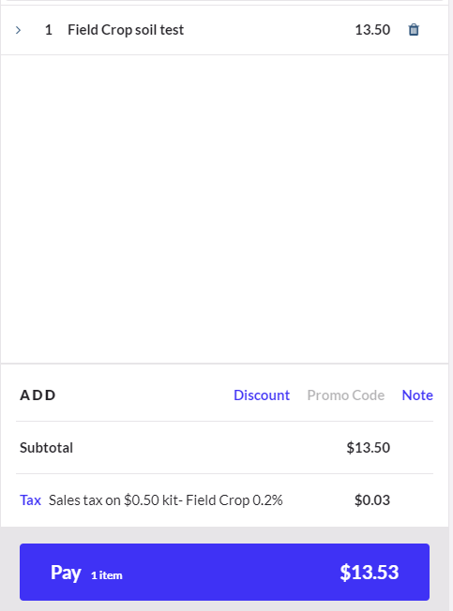
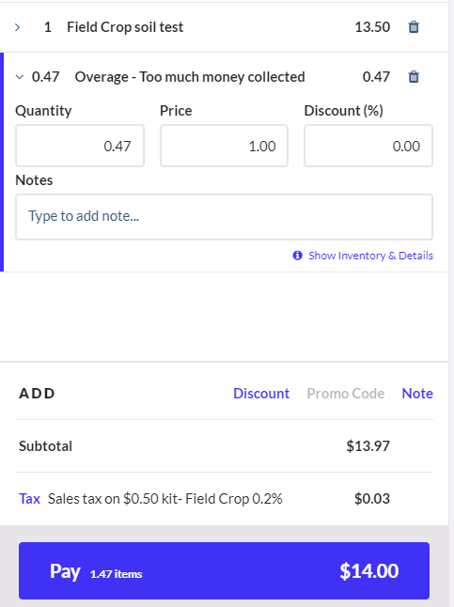
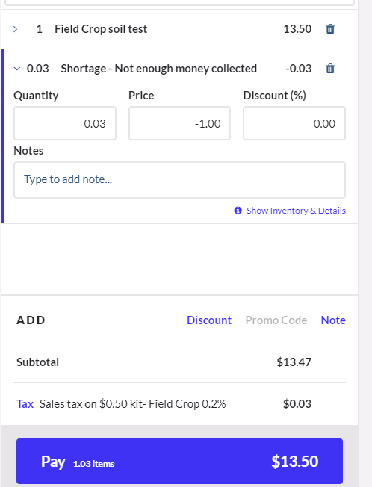
Overage & Shortage, part 2
$13.53 is the correct total to be paid by the customer
Overage of $0.47
Shortage of $0.03

Slide 23
How to make a return, part 1
Managers in the system are the only ones permissible to process a return.
A return should happen in the Extension office when the customer provides the receipt, and you have the money on hand from the original sale. If the original sale took place during a reporting period that you’ve already sent to campus, then likely this will be handled by msue.vend@msu.edu
QR refunds will be a two-step process, first done by the business office in the system. To do so, notify msue@vend.msu.edu the details of the refund, as well as the customer’s name, and I will issue the refund. Secondly, after the transaction has been completed by the business office, staff will complete a matching refund transaction in Lightspeed.
A return should happen if you are in the same deposit reporting period as when the original sale takes place. **A credit card refund can be performed at anytime and is the only exception to this statement.
  Reporting periods are 1st – 15th of the month or 16th – end of the month.
  Example: A customer buys a book on 2/1/2022 and pays cash. Today, 4/29/2022 (2+months later), he comes in for a refund. Since the cash has already been sent to campus, you should collect details and email msue.vend@msu.edu.
  Example: A customer buys a soil test kit on 4/19/2022 and pays cash. Today, 4/29 (10 days later), she comes In for a refund. Find the transaction in the cash register and follow the steps to issue the return. Give the customer cash back.
  Example: A customer buys a 4H book on 3/19/2022 and pays credit card. Today, 4/29/22 (1+month later) he comes in for a refund. Find the transaction in the cash register and follow the steps to issue the return. Process the return using the credit card machine.
  Example: A customer buys a Plat Book on 4/01/2022 and pays check. Today, 4/29/22 (1+month later) he comes in for a refund. It’s likely this check has already been sent to campus….but, because the reporting period just ended, it may be possible to pull the check from the deposit. Collect details and email msue.vend@msu.edu to see if the deposit has been received yet.
Performing a return via cash outside the deposit reporting periods (when cash has been sent to campus) will cause your drawer to be short from the normal operating float. This will then cause additional steps to get the float back to the correct amount.
Returns are done tender to tender- if a customer paid via check and is seeking a refund, you would NOT issue a refund in cash.
If you can’t process the return at the Extension location, request a refund
Send email to msue.vend@msu.edu
Provide following details:
  Why are they requesting a refund?
  Receipt number
  Name of customer
  Current mailing address
  Phone number
  Items to be refunded and amount
MSUE Lightspeed Admin will issue refund via check from MSU and payment will be mailed directly to customer.
If MSUE Vend processes the return, then no transaction will be entered into the cash register system.
If you’re having doubts, reach out and ask for help!

Slide 24
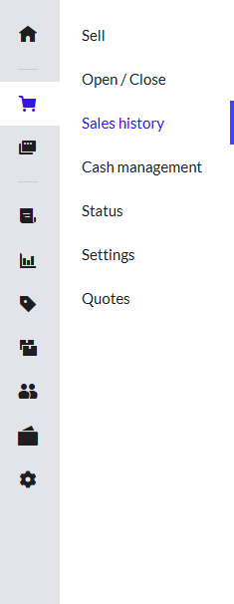
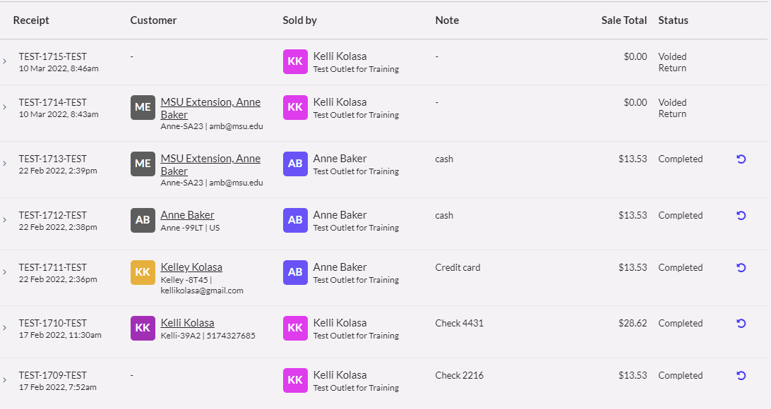
Return, part 2
Find the transaction
Under the sell screen, then sales history, find the receipt.
Click the “arrow” to return the items to the shopping cart.
All items will be returned to the shopping cart, including the customer name.

Slide 25
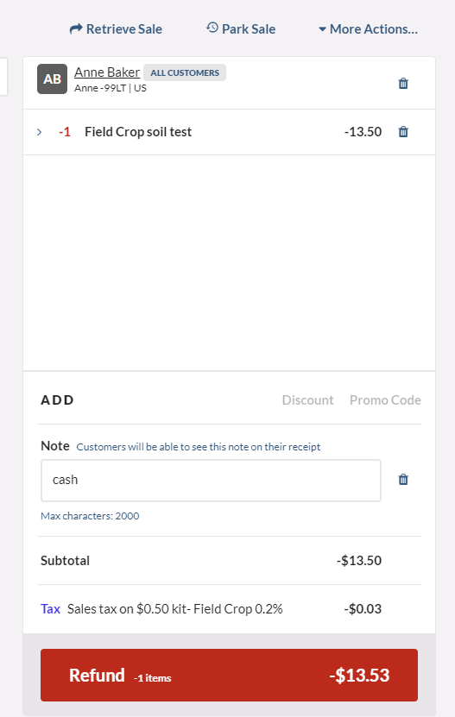
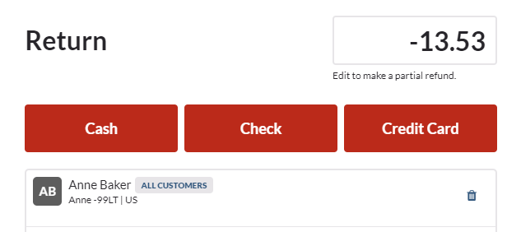
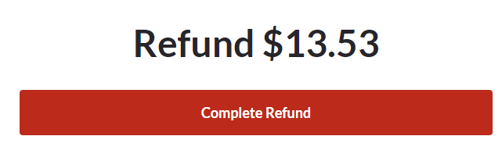
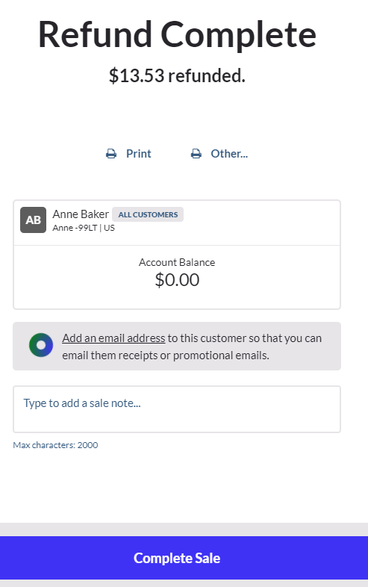
Return, part 3
You can see the item returned to the shopping cart.
*See the negative quantity and the negative dollar amount.
Click refund, and then select how the refund will be given.
Complete refund.
Complete sale.

Slide 26
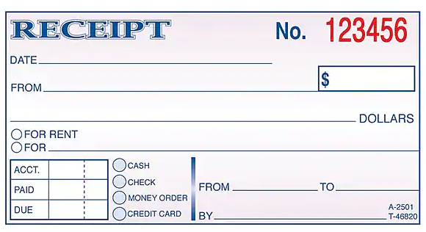
Receipts
Using paper/duplicate receipts (like the example below) should only happen when the payment is collected off-site.
When a customer in is the Extension office, the transaction needs to be entered in Lightspeed the receipt for the customer is generated there.
Each paying customer is expected to receive a receipt for any payment made to MSU Extension.
The cash register prints out a receipt for the customer when they make a payment in the office. You could also email the receipt, too.

Slide 27
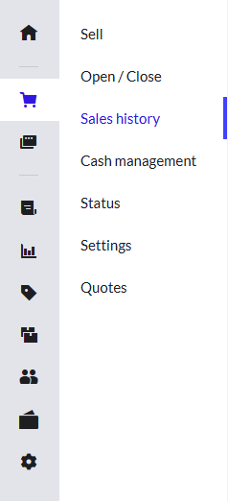
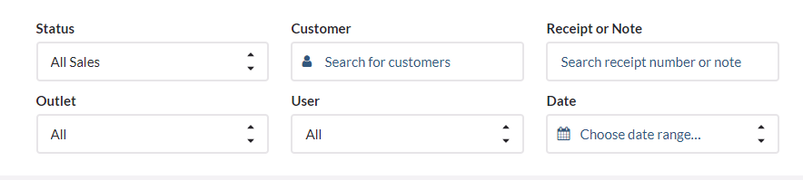
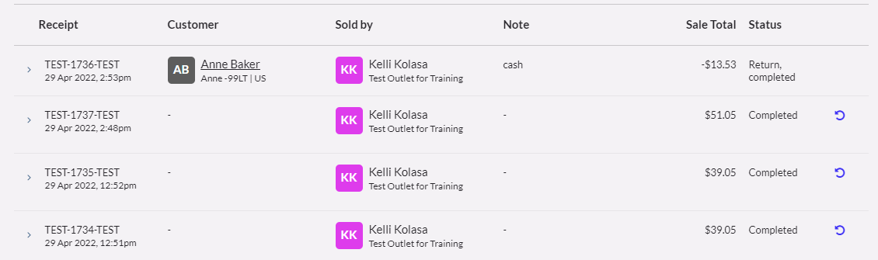
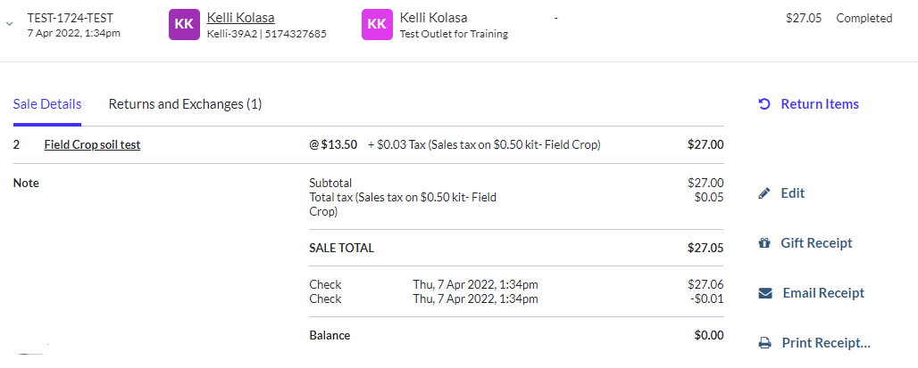
Sales History - reviewing transactions
Use search filters to narrow results
Scroll/page down
Click on arrow to open transaction details
  If you’re trying to find an error, open each transaction and look to see if the payment type is correct.
  Look at any notes provided
  Does the activity make sense?
    Is there change given back on a sale? If so, that should only happen when there is cash payment.
This looks like a problem to me. Why is there change given back on a check payment?

Slide 28
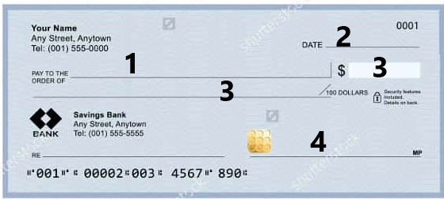
Reviewing checks, part 1
“Pay to the order of” - Acceptable entries: MSU, MSUE, Michigan State Extension, 4H, County 4H, or County Extension (example: Ingham County Extension)
  Checks made out to an individual must be signed over and made Payable to MSU before this can be accepted.
Date should not be older than 5 months
  This is critical! Banks will not accept checks older than 6 months, so keep this in mind when taking a check. Consider time for deposit reporting period, signatures, mailing to campus, etc.
  Be sure there are no date restrictions – “void after 60 days”, etc. This is calculated from the date the check was issued not received.
  Check should not be dated into the future, either.
3. The legal written and numeric amount match exactly.
  If the check is written for two hundred dollars and 20/100 and the numeric amount is $220.00, this is not acceptable. Do not enter the sale. Ask for a new payment.
Ensure that the check is signed by issuer (don’t laugh, this happens more than you think).
If emailing a question about a check and you include a copy – be sure to remove the bank account details from the bottom of the check. This can be done in Adobe and keeps their personal banking details secure.
The number listed on the check corresponds to the details numbered on the right.
5

Slide 29
Reviewing checks, part 2
Additional pieces of information to consider:
  No more than ONE error on the check.
    Fixing Pay to the order of is one error
    Fixing written & numeric amounts are two errors.
    Fixing the address is one error
    Fixing the date is one error
  Checks are not to be dated in the future.
  Add phone number on the check by the name or on memo line
    This helps in instances when the check has errors, needs to be returned or you have to follow up with the customer for a new payment.
  Checks should be stamped for deposit only (including the cash sales check written by the county). No need to add account numbers or amounts- this is provided on the sales reports when the deposit is prepared.

Slide 30
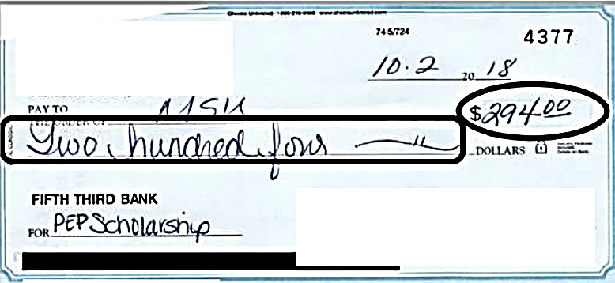
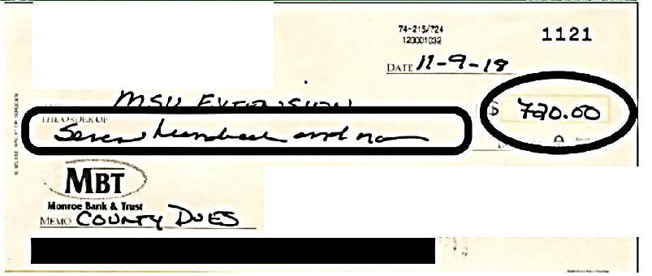
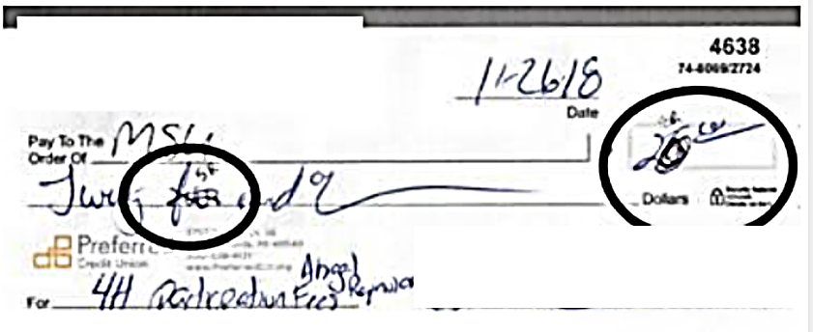
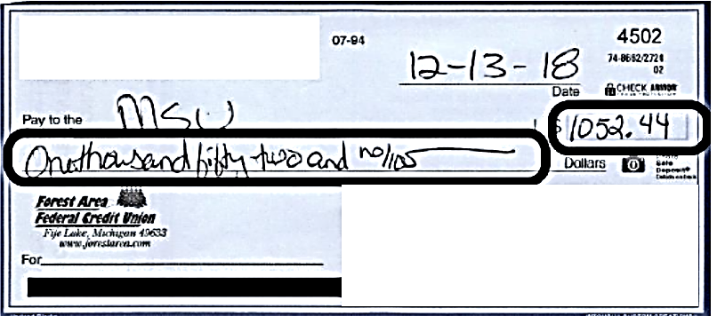
Reviewing checks, part 3 - examples

Slide 31
Closing your register, part 1
Why?
How?
When?
These internal controls are necessary to prevent mishandling of money and to safeguard assets against loss or theft.
Strong internal controls promote operational efficiency, and they also ensure reliable accounting records.
You are prompted to indicate how much cash you have in your drawer. Enter the amount based on what you counted.
Enter the total dollar values for any of the other payment types you accept – like check & credit card
What's been counted and what should be in the register is displayed. If there are discrepancies between the “Expected” & “Counted” fields, then this needs to be investigated.
Working from the iPad, often, the amounts may be pre-populated in the counted column; however, it is your responsibility to enter the actual amount you count.
At the end of each business day, you should close the register and determine if you have any discrepancies in your count based on what you have on hand vs. what the register is reporting.
Pay close attention to details!

Slide 32
Closing your register, part 2
The system will calculate (based on sales entered) what you are expected to have for each type.
Check
Credit card
Cash
Pick up the cash & coin and count what is in the drawer. Enter this amount in the “counted” field.
Pick up the checks and count the amount you have in the drawer. Enter this amount in the “counted” field.
Pick up the signed credit card slips and count the amount you have in the drawer. Enter this amount in the “counted” field.
Never enter the amount without counting the money. Closing the register is an auditing & verification step. As with the opening, you are electronically making an official statement that you’ve counted the money, and this is the amount you have.
While you should have the same amount that the system predicts, mistakes do happen and there could be an instance where a transaction was entered wrong, or wrong cash back is given. There could also be a transaction recording a payment of cash when it should have been a check, etc. When this happens, be sure to report this immediately and utilize the notes section to describe in detail the scenario.
Since this is at the end of the day, you are not expected to stay until the error is fixed; however, you should inform others and work on this ASAP the next day. Reach out to msue.vend@msu.edu.

Slide 33
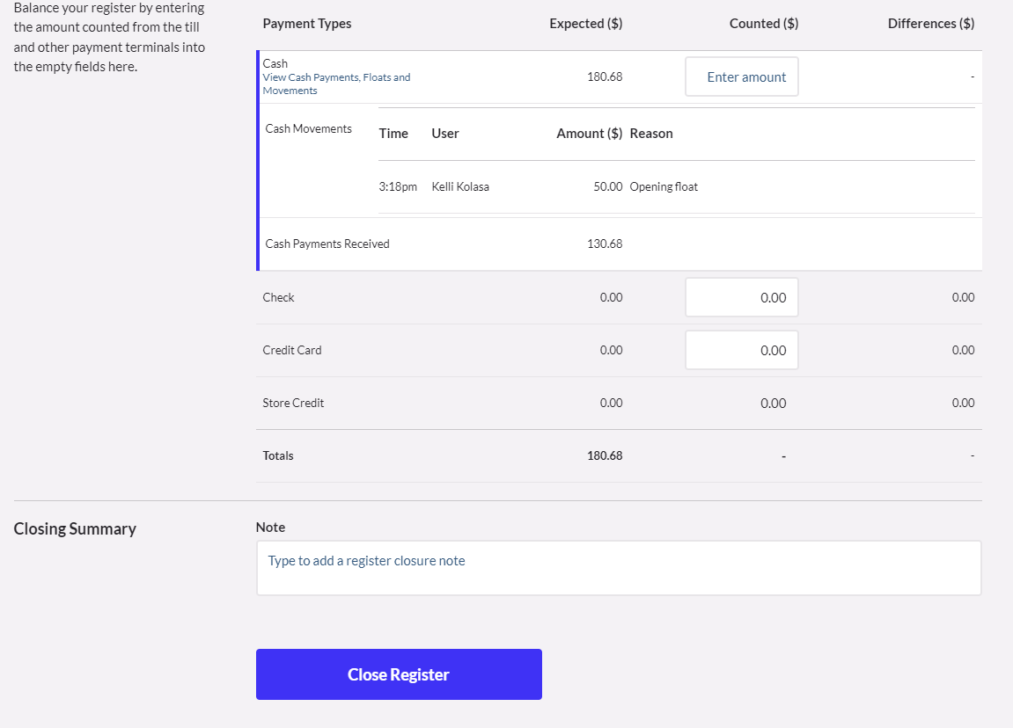
Closing your register, part 3
This is an example of what the screen will look like.
Sometimes, on the iPad, the system can prepopulate the amount in the counted field. I
f that happens, you are still responsible for changing to record the amount you have counted. More than ever, it’s important to be accurate and pay attention to these details.
During this process, take your time to ensure accuracy.
Pay close attention to details!

Slide 34
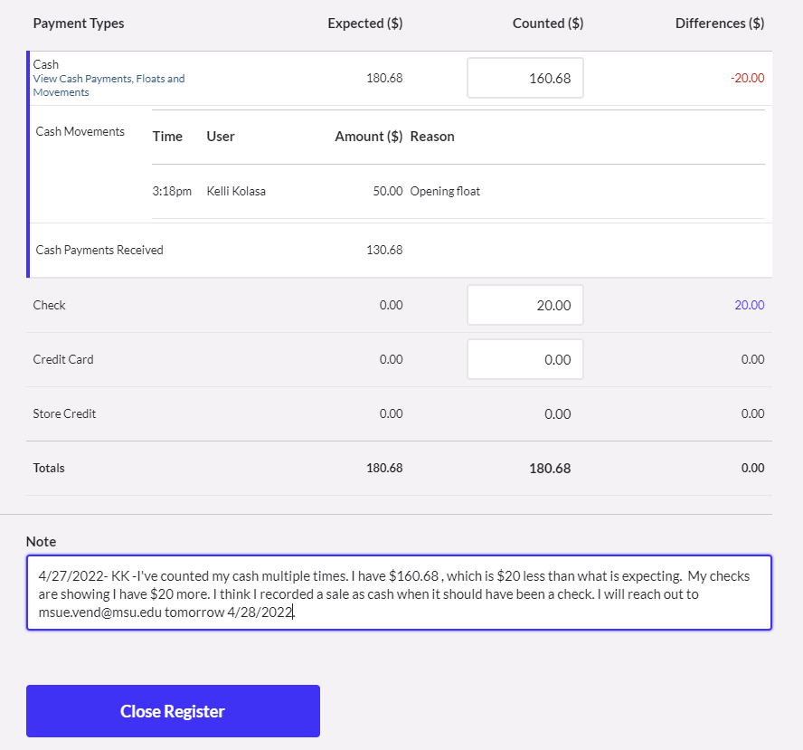
Closing your register, part 4
Amounts have been entered into each field based on the amounts counted.
See how the system automatically changes the amount under the difference column? This is showing an error somewhere that needs to be corrected.
If you are at the end of the day, make a detailed note explaining the circumstances and follow up with msue.vend@msu.edu the next day to correct. Click close register.
(Store credit is not something used.

Slide 35

Preparing & submitting deposits

Slide 36

Important reminders
Resources are available on OD Website
For the quickest response, send all questions to msue.vend@msu.edu
ALWAYS ask questions or ask for help if something doesn’t seem right or if you’re unsure of how to handle a situation.
Create calendar appointments to block off time for preparing deposits to prevent delays.
Deposit reporting periods will never be anything different from:
  1st – 15th
  16th – end of the month
Deposits containing NO SALES or ONLY credit card sales can be emailed to msue.vend@msu.edu
  In the subject line include County & Date range.
  Example: Ingham 3/1 – 3/15/2022

Slide 37
Additional reminders
Deposits need to be submitted in a timely manner.
The manager should start preparing the deposit as soon as the reporting period has ended.
  Not before reporting period has ended.
  Example: today’s date is 3/14/22, I can’t start working on the deposit for 3/1 – 3/15/22 until 3/16/22.
Preparing the deposits are another tool used to verify money you have on hand with what the register is reporting. It’s an auditing feature and needs to be accurate.
All deposit reports must match exactly to money (cash/check/credit card)on hand in order to be submitted.
If there are errors or the amounts do not match, then you’ll need to investigate before submitting. Contact msue.Vend@msu.Edu if you need help.

Slide 38
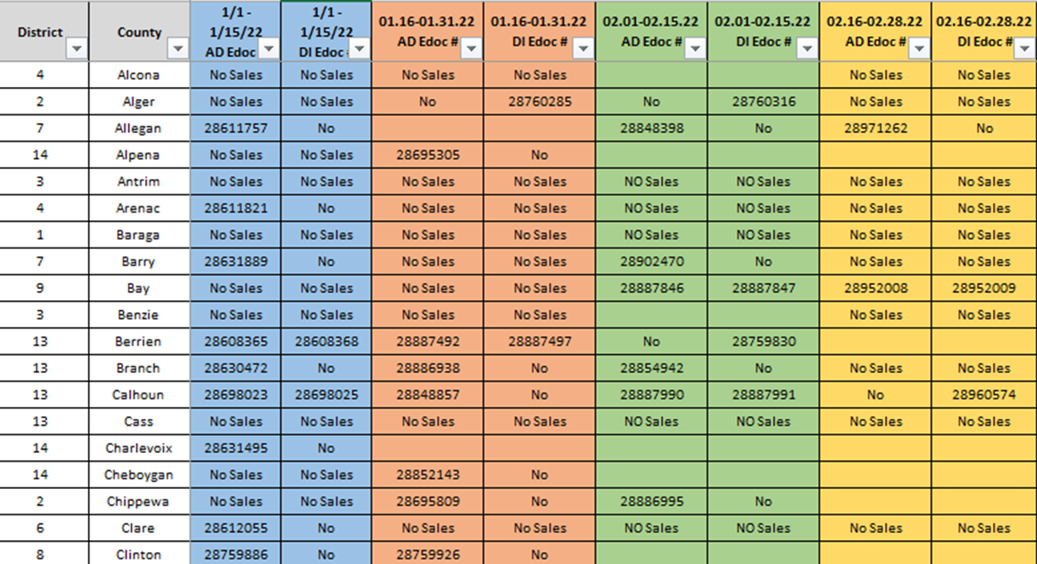
This is an example of a tracking sheet I maintain to identify deposits in each county
How do you know the status of deposits submitted for your county office?
What keeps you organized?
What does your district do?
Collaborate with others to find useful tips/tricks.
Consider maintaining a share drive to submit and store reports.

Slide 39
DEPOSIT REPORTS:
3 reports & why they are needed.
Payments report:
identifies the type of monies collected during the reporting period and reflects cash, check or credit card.
Sales report:
identifies the types of products sold during the reporting period. This also identifies accounts/sub accounts and sales tax.
QR Code Lightspeed Report:
identifies the amount of credit card income collected during the reporting period. This report is generated by Silvija and is to be submitted with each deposit.

Slide 40
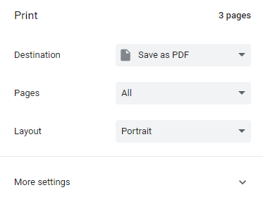
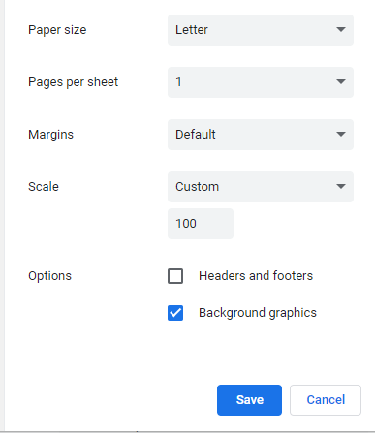

Formatting Printer setting
1. Go to print your reports
Sometimes printed reports appear faint.
While they may be ok to read on paper, after they get scanned in, it’s difficult to read and sometimes illegible.
Follow these simple steps to darken the filter line on the reports.
2. Click more settings to expand options
3. Check the background graphics box to turn the “register with CYI/DIR accounts much darker, which is easier to see when printed.
4. Adjusting the scale will make the font smaller/larger and could change the number of pages.
There are many people involved in auditing reports. Be mindful of copied/faxed reports and fix if they appear blurry or difficult to read.

Slide 41
Formatting Payments report
Report type: “Payment type”
Measure : “Amount”
Date range : “Specify dates” select approved From & To date range, then click apply
More Filter: click, type:
Calhoun DS100113 (CYI) DS100541 (DIR)
  If this doesn’t pop up for you automatically, you may need to type out the full county name with account numbers like the example shows.
  Each county has different DS numbers for CYI & DIR.

Slide 42
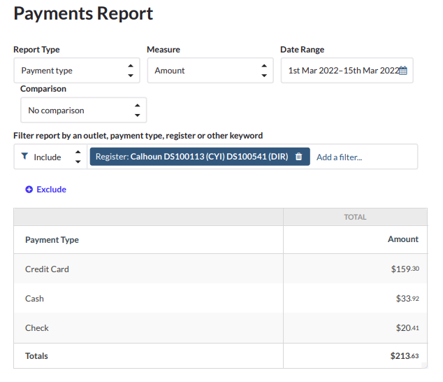
Payments report: Example

Slide 43
Formatting Sales report
Report type: “Product”- shows account/sub account details
Measure : “Revenue”
Date range : “specify dates” select approved From & To date range, then click apply
More Filter: click then type: Calhoun DS100113 (CYI) DS100541 (DIR)
  If this doesn’t pop up for you automatically, you may need to type out the full county name with account numbers like the example shows.
Format Results: Change: By Outlet, then apply
Update added 1/1/2023 – it’s been reported that a web browser update is causing the date range of the sales report to be cut off. Please review the printer and scale settings to reduce the size so that the date range is shown. You may need to change the layout from portrait to landscape.

Slide 44
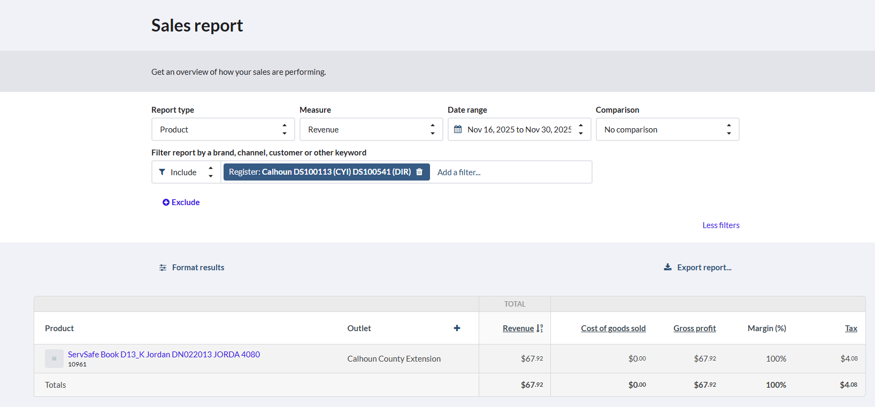
Sales report: Example
Add the Revenue + tax = total on payments report
$210.28 + $3.35= $213.63
Occasionally, you may run into a situation where the sales report total is different from the payments- by pennies. This “could” be from a rounding error on the tax field. If that happens, you can make note that’s where the discrepancy is, and I’ll also make note on the deposit.
Review transaction first to be sure there isn’t an error with the amount collected. If everything checks out, then it’s a rounding issue. Add a handwritten note indicating reports are off due to rounding error with sales tax.

Slide 45
Verifying money on hand matches reports

Slide 46

Cash (and coin)
Physically count the cash and coin
Does this amount match exactly to the Cash amount reported on the payments report?
If yes, move on to Checks
If no, stop here:
  Why doesn’t this amount match?
  Did you double count your cash/coin
  Could another person count?
  Did you check your safe or drawer to see if any cash/coin was left behind?
  Review transactions to find potential discrepancies
  Reach out to msue.vend@msu.edu to fix any errors

Slide 47
Checks
Review Checks:
  Are all checks made payable to MSU, MSU Extension?
  Are all checks signed by the issuer?
  Do the written & numeric amounts match on the check?
  Do any checks have date stipulations “Void after x days” that will be affected?
  Are the checks stamped on the back “for deposit only MSUE”
    You don’t need to fill in the account numbers on the back – that is already done on the sales reports
Physically count the check totals
  Does this amount match exactly to the to the check amount reported on the payments report?
If yes, move on to Credit Card
If no, stop here:
  Why doesn’t this amount match?
  Did you double count your checks?
  Could another person count?
  Did you check your safe or drawer to see if any checks were left behind?
  Review transactions to find potential discrepancies
  Reach out to msue.vend@msu.edu to fix any errors

Slide 48

QR Credit Card
Obtain QR Report run by Silvija
Does this amount match exactly to the amount reported as credit card on the payments report?
If yes, move on to submitting
If no, stop here:
  Why doesn’t this amount match?
  Check your report dates
  Could another person review?
  Review transactions to find potential discrepancies
  Reach out to msue.vend@msu.edu to fix any errors

Slide 49
Cash sales / Local Bank
Now that all the monies (cash, check & credit card) match the reports, you can make the cash deposit to your local bank account.
Obtain deposit receipt from banking institution.
Request a cash sales check from your District Support (or authorized person) by providing receipt/proof of the cash deposit.
Wait to receive this cash sales check before combining with other checks and reports to mail to campus.

Slide 50
Final check
Now that you have run all reports & you have verified the money on hand matches exactly to the reports say, you should do one more review for the following:
  Approval from District Director (or authorized signer). This can be handwritten or electronic.
  Preparer’s name/email on one page of the 3 reports.
  Additional documents to be included:
    Donations received require a donation/gift form to be completed.
      Identified by reviewing sales reports – when an account begins with RN- that’s an indicator that a gift form is needed.
      This form gets updated periodically, so check back to make sure you have the most updated form.
      Common areas folks forget: Intent/purpose & account information
    Third Party donations – sometimes have a portal to login and find details- if you need help, reach out to msue.vend@msu.edu. I have set up logins for many 3rd party sites.

Slide 51
Submitting deposits
Step 1
Gather the 3 reports
Payments, Sales & QR Credit card
Step 2
Gather checks and/or cash sales checks
Step 3
Gather any supporting documents
(Gift forms, Edoc # for expense abatements, etc.)
Step 4
Add your name & email/phone to one report
Step 5
Gather Approval
Step 6
Place in envelope and mail:
MSU Extension Business Office
446 W Circle, Room 160
East Lansing, MI 48824
If emailing reports, COMBINE in ONE PDF – preferably in this order:
Payments reports, sales reports, Credit card, email approval, gift forms and any additional information. Make sure all documents are facing right side up.

Slide 52
Common mistakes
Not following established procedures.
Not adding customer names or payment details in the correct notes section.
Not physically counting the cash when opening the register.
  Assuming the amount to start with because “we always have this on hand” is not an acceptable business practice. Performing the opening process, and entering a dollar amount for the float, the cashier is validating the dollar amount of the starting float.
Not verifying amounts during the closure of the register.
  The closure process is an auditing tool to verify that the activity (sales) that was entered is accurate to the money collected.
  iPads can populate amounts into the fields where the cashier is supposed to enter the amounts, they “COUNTED”. Often, cashier’s just click through the process quickly to close the register. This is a problem. Assuming the amount at the close because “that’s what the screen is saying we have” is not an acceptable business practice. Performing the closing process, and entering a dollar amount for each tender type, the cashier is validating the dollar amount of each tender type.
Transactions with errors showing wrong payment type or incorrect change given can be identified the day it happens, rather than waiting for the deposits reports to be prepared. Usually, that’s how I can identify cashiers aren’t following the process of closing the register properly.
Trying to fix errors causing duplicate entries and a domino effect of additional errors.
  Rather than try and fix something yourself, its best to just reach out to msue.vend@msu.edu and explain the situation. Often there is a simple solution and can involve just one transaction.

